Slide 1
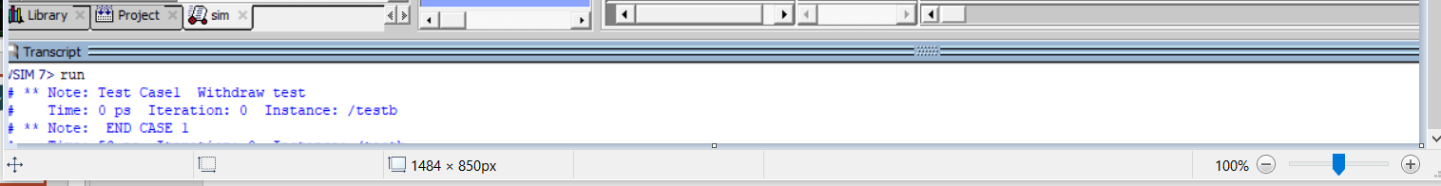
TESTBENCH WAVE FORM (1) Withdraw

Slide 2
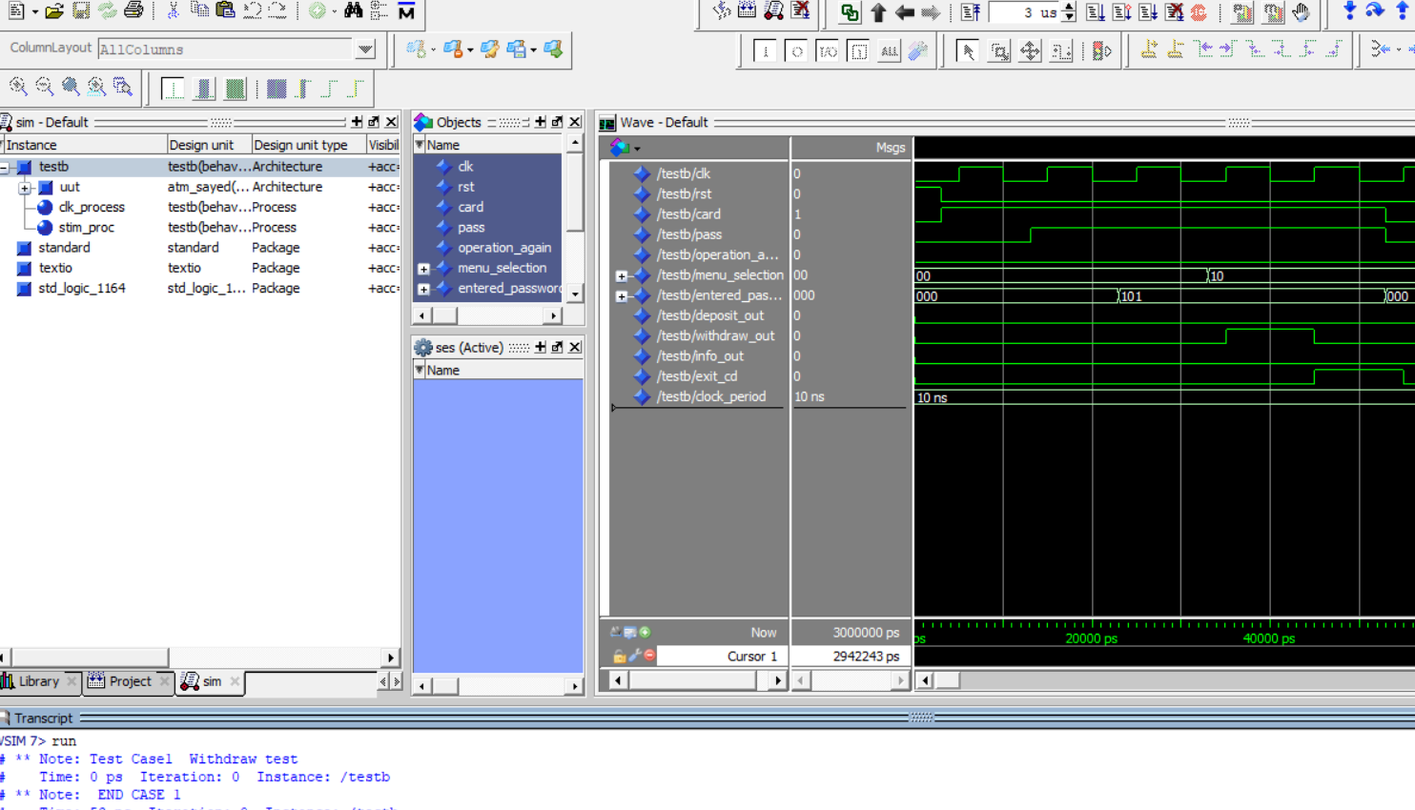
TESTBENCH WAVE FORM (1) Withdraw

Slide 3
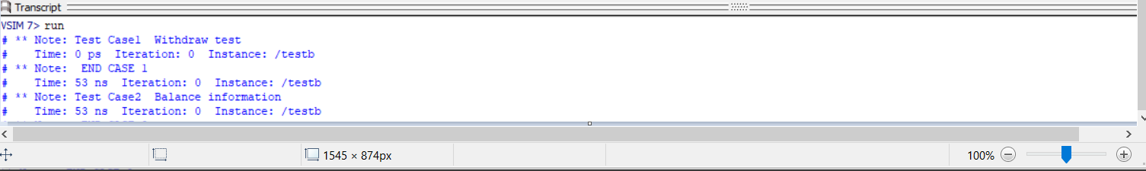
TESTBENCH WAVE FORM (2) Balance information

Slide 4
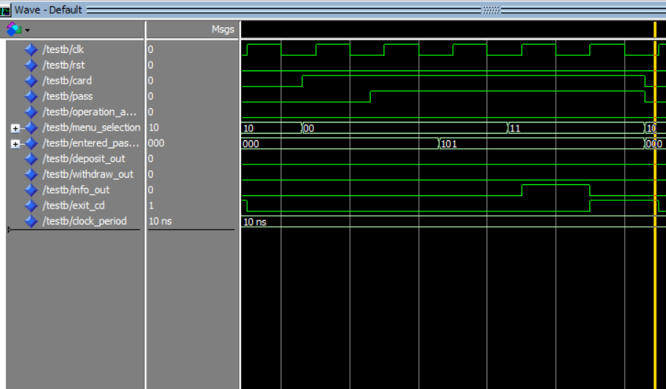
TESTBENCH WAVE FORM (2) Balance information

Slide 5
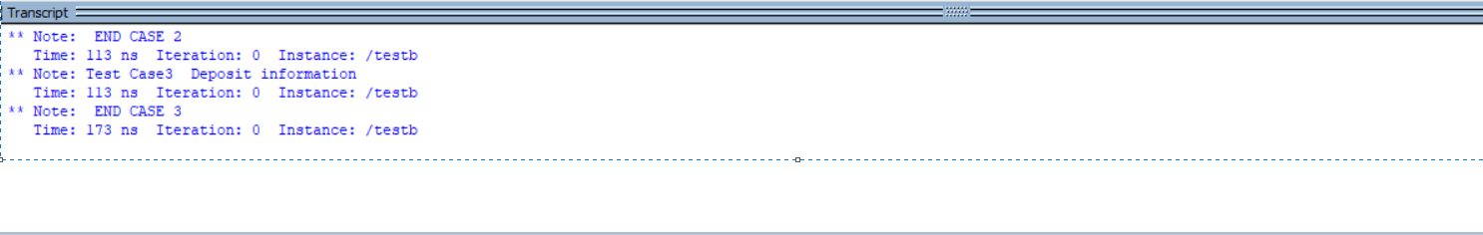
TESTBENCH WAVE FORM (3) deposit

Slide 6
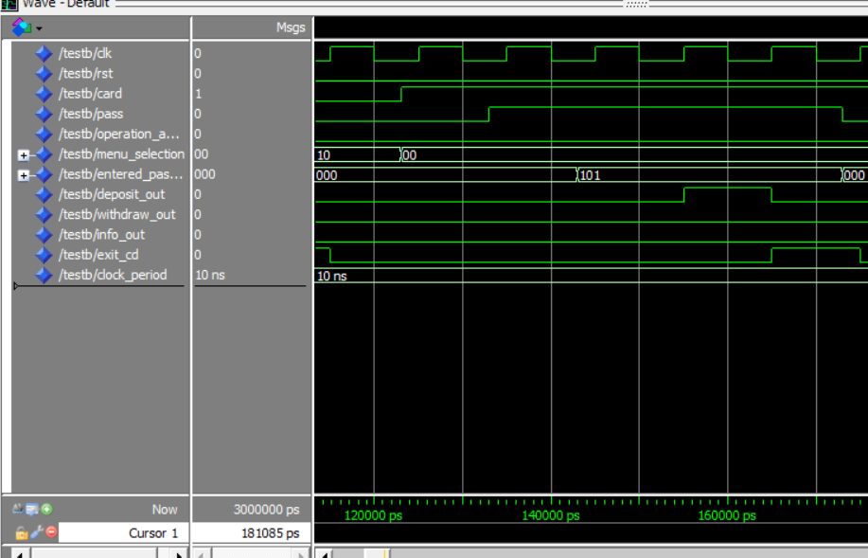
TESTBENCH WAVE FORM (3) deposit

